Slide 1

The Grading of Recommendations, Assessment, Development, and Evaluation (GRADE)
ATS Document Development and Implementation Committee Workshop
Denver, Colorado
May 13, 2011

Slide 2









Slide 3
The GRADE approach
Formulate your question.
Determine the outcomes of interest.
Conduct a systematic review of the literature.
Choose your threshold magnitude of effect.
Estimate the effect of the intervention.
Appraise the quality of evidence.
Formulate the recommendation.
Determine the strength of the recommendation.
Grade the recommendation.

Slide 4
Step 1

Slide 5
Step 1: Formulate your question
Begin by formulating your question using the PICO format:
  P: Population
  I: Intervention
  C: Comparator
  O: Outcomes

Slide 6
Step 1: Formulate your question
Examples:
  Should patients with COPD and an FEV1 of 50 to 80% be referred for pulmonary rehabilitation?
  Should patients with group 1 PAH and a WHO functional classification of III be treated with a prostanoid or an endothelin receptor antagonist?

Slide 7
Step 1: Formulate your question
Michael Gould is conducting a separate session about formulating clinical questions using PICO, if you desire additional details about this step.

Slide 8
Step 2

Slide 9
Step 2: Determine the outcomes
Brainstorm and list all patient-important outcomes.
  Mortality, length of stay, and dyspnea are patient-important outcomes.
  In contrast, FEV1 and oxygenation are not patient-important outcomes.

Slide 10
Step 2: Determine the outcomes
Prioritize the outcomes as critical, important, or informative.
9 | critical
8
7
6 | important, but not critical
5
4
3 | informative, but not important
2
1

Slide 11
Step 2: Determine the outcomes
This should be done carefully because the quality of evidence that you will eventually assign to the recommendation is the lowest quality of evidence among the critical outcomes.

Slide 12
Step 2: Determine the outcomes
Examples:
Outcome | Priority | Quality of Evidence
Mortality | Critical | High
Frequency of hospitalization | Very important | Moderate
Dyspnea | Very important | Moderate
The overall quality of evidence is high.
Outcome | Priority | Quality of Evidence
Mortality | Critical | High
Frequency of hospitalization | Critical | Moderate
Dyspnea | Very important | Moderate
The overall quality of evidence is moderate.

Slide 13
Step 3

Slide 14
Step 3: Conduct a systematic review
A systematic review should be conducted to identify the evidence related to the population, intervention, comparator, and outcomes that you identified in steps 1 and 2.
This is the most time-consuming step in the application of GRADE.

Slide 15
Step 3: Conduct a systematic review
Jan Brozek is conducting a separate session about performing a systematic review, if you desire additional details about this step.

Slide 16
The following steps must be performed
for each outcome.

Slide 17
Step 4

Slide 18
Step 4: Choose a threshold magnitude of effect
Decide upon the magnitude of effect that warrants a change in clinical practice.
This will depend upon the importance of the desirable effects of the intervention and the seriousness of the potential undesirable effects.

Slide 19
Step 4: Choose a threshold magnitude of effect
A large magnitude of effect should be chosen if the benefits are minor, the potential harms are serious, or the cost is high.
In contrast, a smaller magnitude of effect may be chosen if the benefits are important, the potential harms are minor, or the cost is low.

Slide 20
Step 4: Choose a threshold magnitude of effect
Examples:
  A small magnitude of effect is sufficient to recommend aspirin during an acute MI, since decreased mortality is important, serious harms are rare, and the cost is low.
  A large magnitude of effect would be necessary to recommend thrombolysis for DVT because the benefit (decreased chronic venous stasis) is minor and the harms (intracranial hemorrhage) are serious.

Slide 21
Step 5

Slide 22
Step 5: Estimate the effect of the intervention
If the systematic review included a meta-analysis, then the result of the meta-analysis gives the estimated effect.
If the systematic review did not include a meta-analysis, then individual studies are needed to inform judgments about the estimated effect.

Slide 23
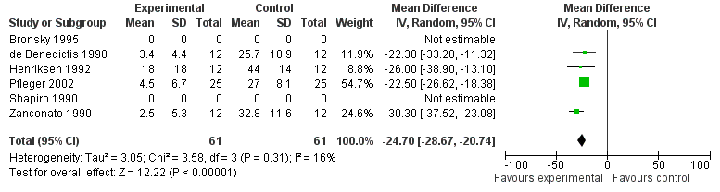
Step 5: Estimate the effect of the intervention
The estimated effect of inhaled short-acting beta-agonists is MD -24.70 (95% CI -28.67—20.74).

Slide 24
Step 6

Slide 25
Step 6: Assess the quality of evidence
The “quality of evidence” is the confidence that you have that the direction and the magnitude of the estimated effect are correct.
Quality of evidence | Suggested implications
High | further research is unlikely to change the confidence in an estimated effect; we are confident that we can expect very similar effect in a population for which the recommendation is intended
Moderate | further research is likely to have an important impact on the confidence in an estimated effect and may change that estimate
Low | further research is very likely to have an important impact on the confidence in an estimated effect and is likely to change that estimate
Very low | any estimate of an effect is very uncertain

Slide 26
Step 6: Assess the quality of evidence
Make a baseline assumption:
  Randomized trials = high quality evidence.
  Observational studies (i.e., case-control studies and controlled prospective or retrospective cohort studies) = low quality evidence.
  Unsystematic observations (i.e., case series, case reports, clinical experience) = very low quality evidence.

Slide 27
Step 6: Assess the quality of evidence
Look for reasons to downgrade the quality of evidence (i.e., factors that lower your confidence in the estimated effect):
  Risk of bias
  Inconsistency
  Indirectness
  Imprecision
  Reporting bias

Slide 28
Step 6: Assess the quality of evidence
Risk of bias:
  Concealment -- Intention to treat
  Patient blinded -- Baseline differences
  Caregiver blinded -- Selection bias
  Assessor blinded -- Statistical analysis
  Objective outcome
  Loss to follow-up
  Stopped early for benefit

Slide 29
Step 6: Assess the quality of evidence
Inconsistency: Inconsistency exists when there is substantial variation in the direction or size of the effect across studies.
  I² test.
  P-value of heterogeneity.
  “Eye ball” test.

Slide 30
Step 6: Assess the quality of evidence
Indirectness: Indirectness exists when the population, intervention, comparator, or outcome of the clinical question differ from that in the studies.
Examples:
  Population: Your question is related to pneumococcal vaccination in the elderly, but the relevant studies were conducted in adults of all ages.

Slide 31
Step 6: Assess the quality of evidence
  Intervention: Your question is related to the use of static resistance training for pulmonary rehabilitation in patients with COPD, but the relevant studies looked at dynamic resistance training.
  Comparator: Your question is related to chlorhexidine versus oral digestive decontamination, but the relevant studies compared chlorhexidine to placebo and oral digestive decontamination to placebo.

Slide 32
Step 6: Assess the quality of evidence
  Outcomes: Your question is related to the effect of leukotriene receptor antagonists on exercise capacity in patients with exercise-induced bronchoconstriction, but all of the studies measured the impact of leukotriene receptor antagonists on FEV1.

Slide 33
Step 6: Assess the quality of evidence
Imprecision: Imprecision exists if the ends of the confidence interval lead to different clinical conclusions. In other words, the trial was too small to definitively answer the clinical question.

Slide 34
Step 6: Assess the quality of evidence
RR 0.70, 95% CI 0.50-0.90
RR 0.70, 95% CI 0.30-1.10
RR 0.70, 95% CI 0.43-0.97
Benefit
No effect
Harm

Slide 35
Step 6: Assess the quality of evidence
Reporting bias: Reporting bias is the preferential reporting, publishing, and dissemination of data that is statistically significant, shows a large effect, and/or demonstrates a benefit.
Reporting bias is notoriously difficult to detect.
There are three variations of reporting bias:
  Publication bias
  Selective outcome reporting bias
  Lag bias

Slide 36

Step 6: Assess the quality of evidence
Publication bias exists if a study is never reported or published.

Slide 37
Step 6: Assess the quality of evidence
Publication bias exists if a study is never reported or published.
“The results of Study 15 were never published or shared with doctors, even as less rigorous studies that came up with positive results for Seroquel were published and used in marketing campaigns aimed at physicians and in television ads aimed at consumers.”

Slide 38
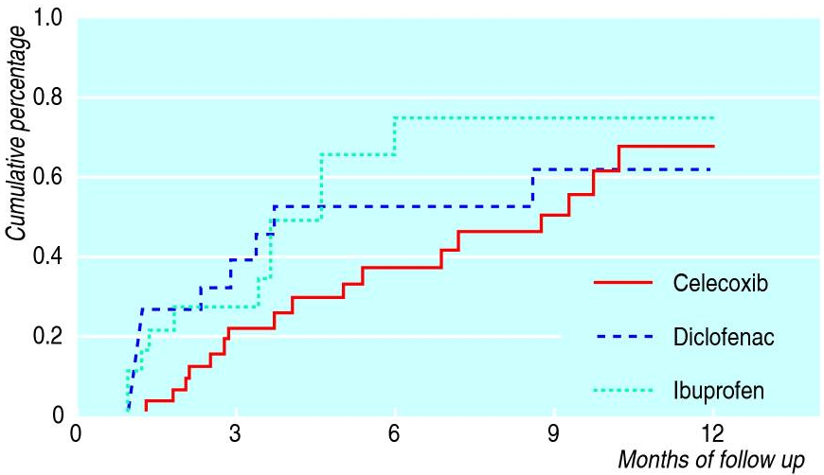
Step 6: Assess the quality of evidence
Selective outcome reporting bias exists if favorable outcomes are reported, while unfavorable outcomes are not.

Slide 39
Step 6: Assess the quality of evidence
Selective outcome reporting bias exists if favorable outcomes are reported, while unfavorable outcomes are not.

Slide 40
Step 6: Assess the quality of evidence
Lag bias exists if the reporting or publishing of negative trials is delayed.
Ioannidis JP. JAMA 1998; 279(4):281.
  N=109 clinical trials
  Median duration from trial completion to publication
    Negative trials – 3.0 years
    Positive trials – 1.7 years
Hopewell S, et al. Cochrane Database Syst Rev 2003; 4:MR000011.
  N=196 clinical trials
  Median duration from trial initiation to publication
    Negative trials – 6 to 8 years
    Positive trials – 4 to 5 years

Slide 41
Step 6: Assess the quality of evidence
The net result of publishing positive and not negative studies is that the body of evidence then exaggerates the effect of the intervention. The evidence may suggest that an intervention has an effect even if the truth is no effect, or may indicate that an intervention has a large effect even if the truth is a small effect.
Generally speaking, you should be concerned about reporting bias if the body evidence consists of many small trials showing a large benefit, especially if the trials were industry funded.

Slide 42
Step 6: Assess the quality of evidence
Look for reasons to upgrade the quality of evidence (i.e., factors that increase your confidence in the estimated effect):
  Large effect
  Dose-response effect
  Reverse confounding

Slide 43
Step 6: Assess the quality of evidence
Large effect: The effect size is determined by looking at the relative effect, rather than the absolute effect.
  An effect is considered “large” if the RR is ≥2 but less than 5, or if the RR is ≤0.5 but >0.2 –> upgrade one level.
  An effect is considered “very large” if the RR is ≥5 or <0.2 –> upgrade two levels.

Slide 44
Step 6: Assess the quality of evidence
Dose-response effect: A dose-response effect is present if a more intense intervention (i.e., larger dose, longer duration) leads to a larger effect over varying levels of the intervention.

Slide 45
Step 6: Assess the quality of evidence
Reverse confounding: Called various things because there is no good descriptive term. Exists if:
  All conceivable confounders would underestimate the effect, but the study found an effect.
  All conceivable confounders would overestimate the effect, but the study found no effect.

Slide 46
Step 6: Assess the quality of evidence
Make a baseline assumption based upon the study design.
Look for reasons to downgrade or upgrade the quality of evidence:
  Downgrade Upgrade
  Risk of bias -- Large effect
  Inconsistency -- Dose-response gradient
  Indirectness -- Reverse confounding
  Imprecision
  Reporting bias

Slide 48
Step 7

Slide 49
Step 7: Formulate the recommendation
The decision to recommend an intervention (or recommend against an intervention) should take into account the following:
  The balance of desirable and undesirable effects.
  The quality of evidence.
  Patient values and preferences.
  Burden, resource utilization, cost, and feasibility.

Slide 50
Step 7: Formulate the recommendation
The recommendation should be written using the PICO format:
  For patients with exercise-induced asthma, we recommend/suggest an inhaled short-acting bronchodilator administered 15 minutes prior to exercise.
  For patients with sickle cell disease-related pulmonary hypertension, we recommend/suggest hydroxyurea therapy.

Slide 51
Step 8

Slide 52
Step 8: Determine the strength of the recommendation
For each recommendation, the strength of the recommendation needs to be determined.
A recommendation may be strong or weak.

Slide 53
Step 8: Determine the strength of the recommendation
A strong recommendation:
  There is certainty desirable consequences of the intervention substantially outweigh the undesirable consequences.
  Virtually all well-informed patients would want the intervention and only a few would not.
  “Just do it”.
  A clinician is wrong if he/she does not follow the recommendation.
  A reasonable performance measure.

Slide 54
Step 8: Determine the strength of the recommendation
A weak recommendation:
  There is uncertainty that the desirable consequences of the intervention outweigh the undesirable consequences.
  The desirable and undesirable consequences are finely balanced.
  Most well-informed patients would want the intervention, but a substantial minority of patients may not.
  “Slow down, think about it, discuss it with the patient”.
  Not an appropriate performance measure.

Slide 55
Step 8: Determine the strength of the recommendation
Generally speaking, the number of weak recommendations should exceed the number of strong recommendations.

Slide 56
Step 9

Slide 57
Step 9: Grade the recommendation
Each recommendation should be followed by the strength of the recommendation and quality of evidence.
Strong recommendations should include, “we recommend”.
Weak recommendations should include, “we suggest”.

Slide 58
Step 9: Grade the recommendation
Examples:
  For patients with exercise-induced asthma, we recommend an inhaled short-acting bronchodilator administered 15 minutes prior to exercise (strong recommendation, high quality evidence).
  For patients with sickle cell disease-related pulmonary hypertension, we recommend hydroxyurea therapy (strong recommendation, high quality evidence).

Slide 59
The GRADE approach
Formulate your question.
Determine the outcomes of interest.
Conduct a systematic review of the literature.
Choose your threshold magnitude of effect.
Estimate the effect of the intervention.
Appraise the quality of evidence.
Formulate the recommendation.
Determine the strength of the recommendation.
Grade the recommendation.

Slide 60
Questions? kwilson@uptodate.com

